Slide 1
Gauge Length Parameter

Slide 2
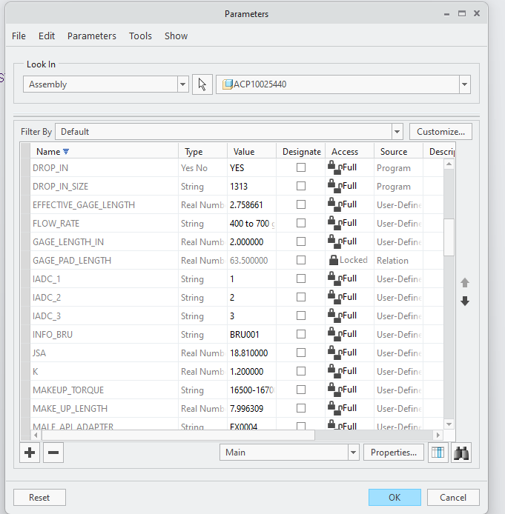
Creating Parameter
Tools > Parameters
Click "+", name GAGE_PAD_LENGTH
Set Type to Real Number, click OK

Slide 3
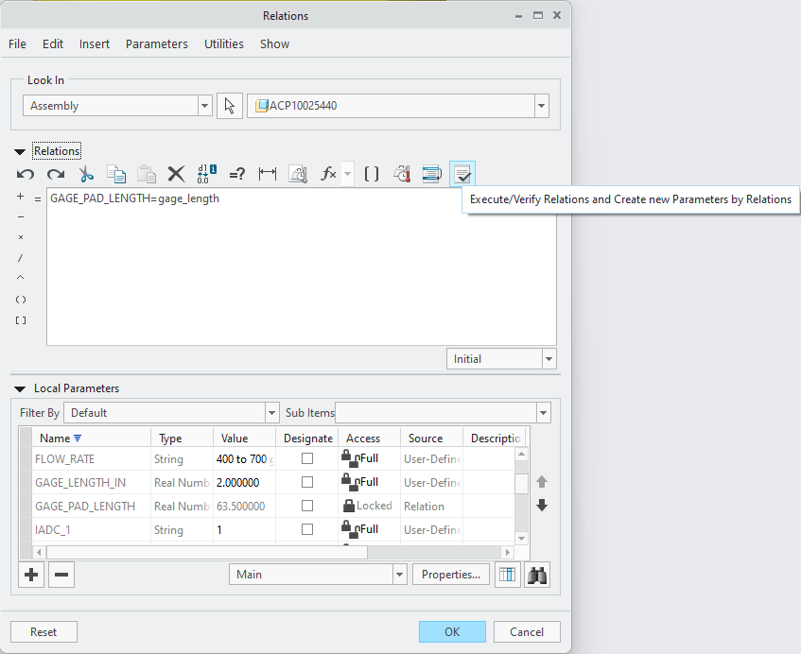
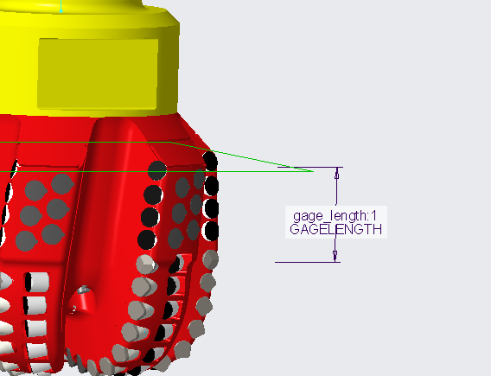
Creating Parameter Relation
Right click GAGE_LENGTH in Model Tree
Select Edit Dimensions ("dl" symbol)
Tools > Switch Dimensions
Tools > Relations
Right click GAGE_PAD_LENGTH > Insert to Relations > type "="
Select dimension to add to relation equation
Select Execute/Verify to finalize
7
6
5

Slide 4
Last Slide

